Slide 1
Welcome to ZikAsh
Welcome to ZikAsh Restaurant

Slide 2
About Us
ZikAsh is where flavor meets culture. We serve a wide variety of Indian and international dishes in a warm, elegant setting.

Slide 3


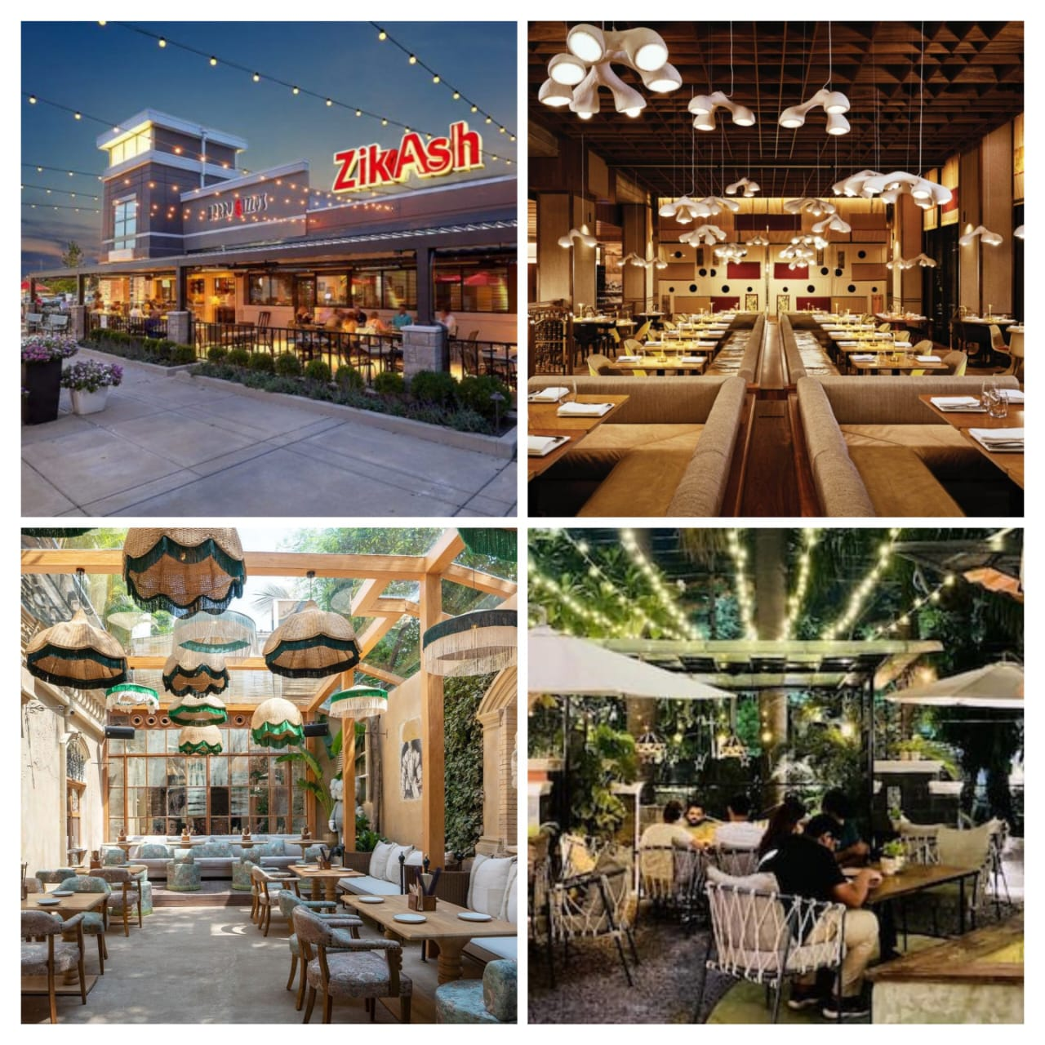
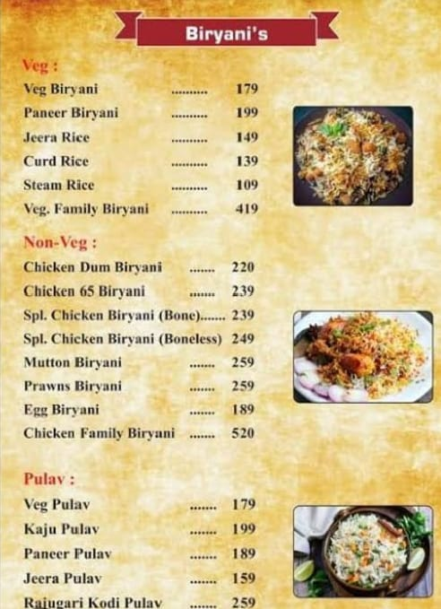
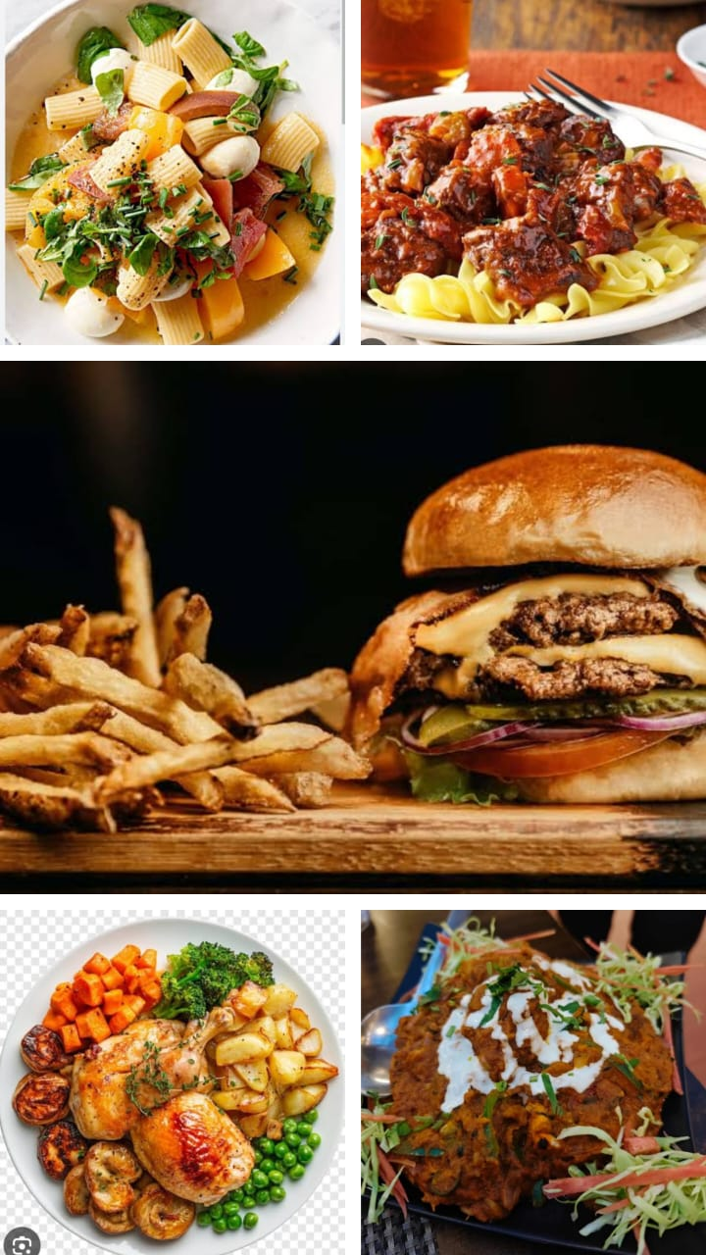
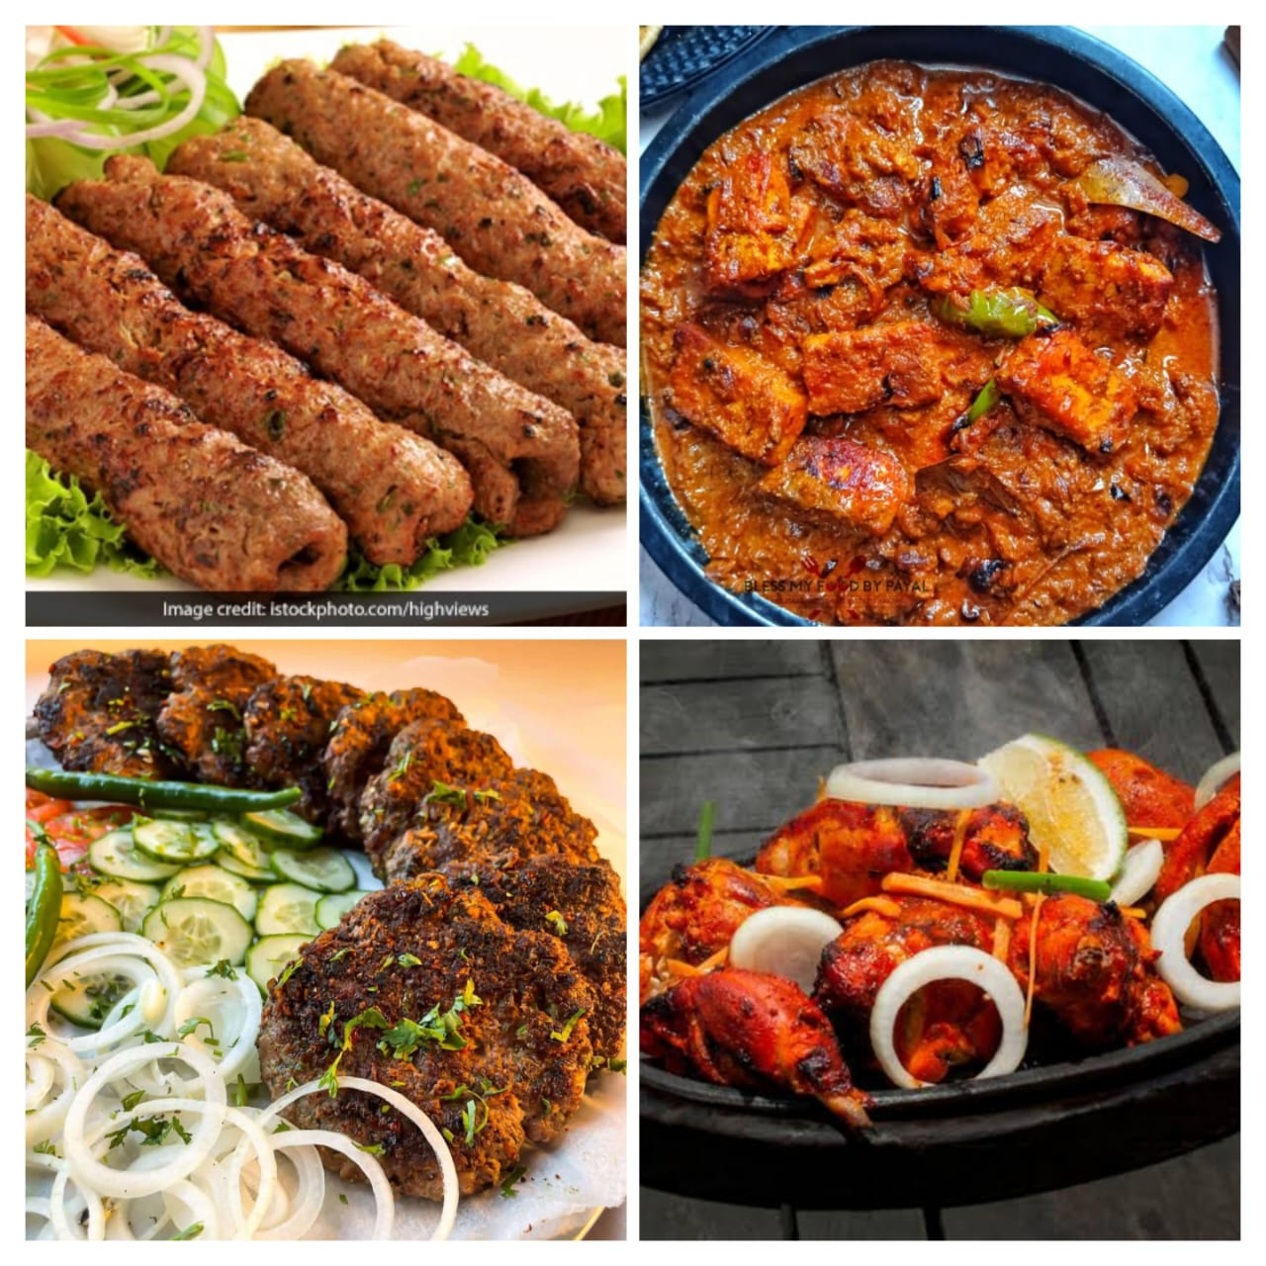
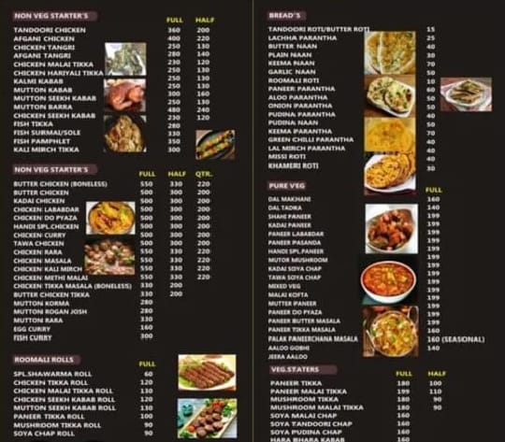

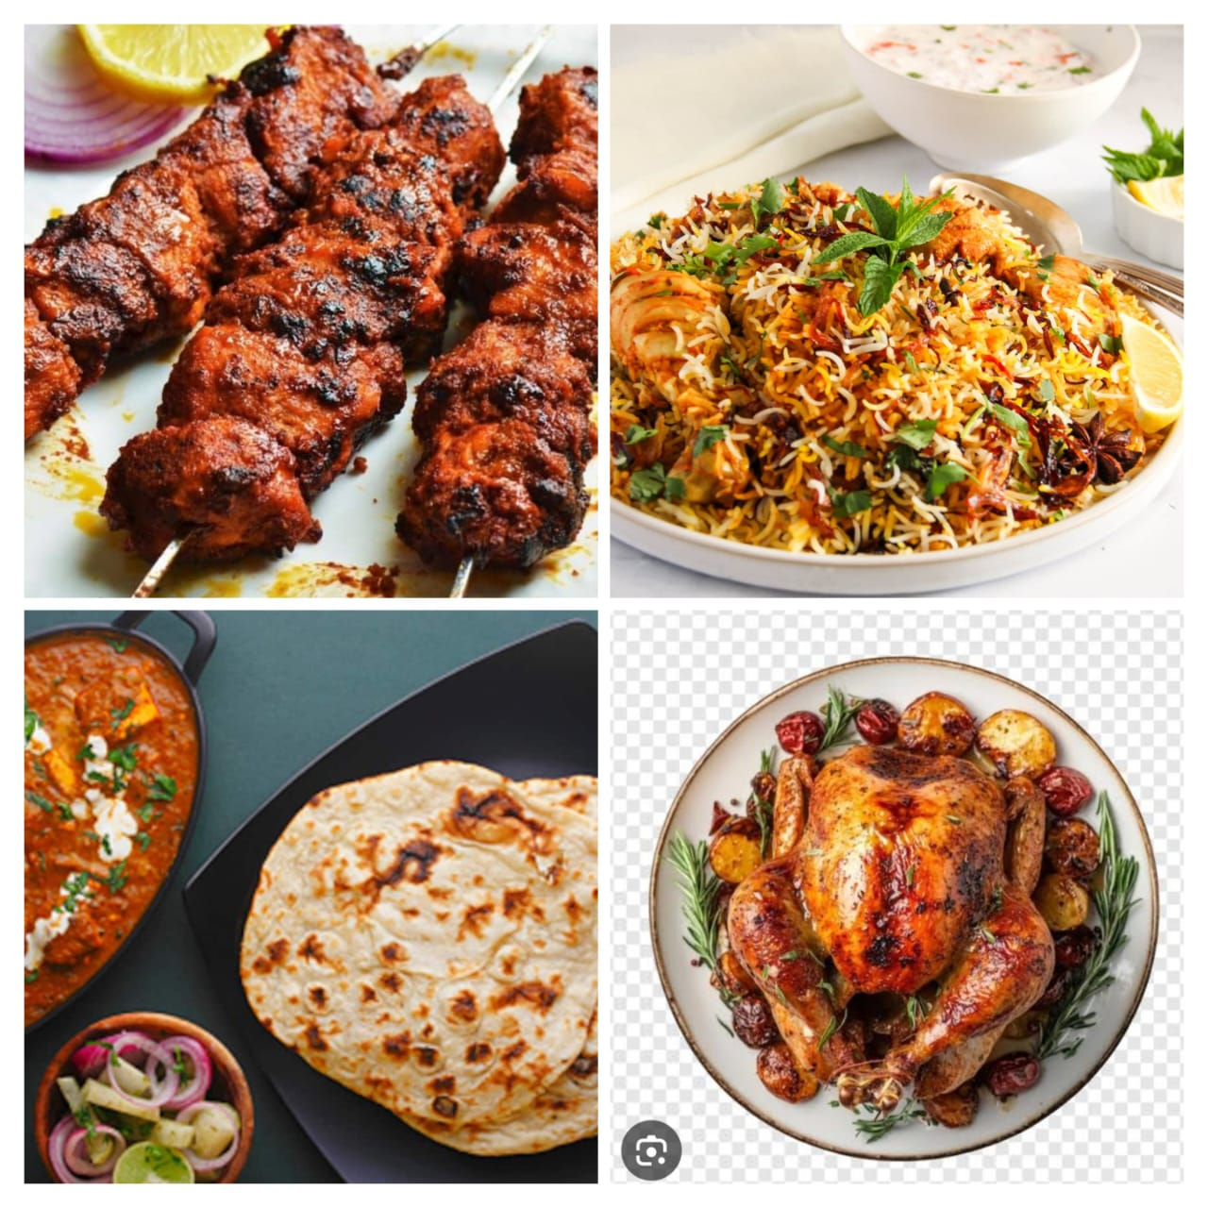
Menu Highlights

Slide 4
Special Features
- Menu Filtering
- Table Reservation Popup
- Hygienic Food Preparation
- Great Ambience

Slide 5
Delivery Services
Enjoy your meals at home!
• Fast delivery in 30–45 mins
• Contactless packaging
• Live tracking
• Order via phone or website

Slide 6
Customer Reviews
⭐⭐⭐⭐⭐ - 'Amazing food and fast delivery!' - Rani
⭐⭐⭐⭐⭐ - 'Best biryani I've ever had!' - Ayaan

Slide 7
Contact Us
📧 contact@zikashrestaurant.com
📞 +91-9876543210
📍 ZikAsh Lane, Foodie Street, India

Slide 8
Thank You
Submitted by Zikra Karim

